Slide 1
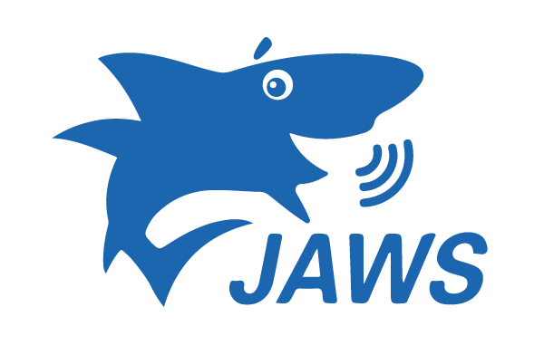
Screen reader Program comparison

Slide 2
Overview of presentation
What are screen readers?
Introduction to JAWS and NVDA
Software comparison
Impressions of each program

Slide 3
What Are Screen Readers
Screen readers are an assistive technology that allow people with low vision or other impairments to use a computer (Göransson, 2019). Screen readers read all text on the screen and convert elements on a screen, including images, buttons, and navigation items into speech or braille.
Photo by Mikail Nilov

Slide 4
Introduction to JAWS
JAWS is short for Job Access With Speech
Created by Freedom Scientific, which is based in the United States
Initially released in 1995
Can be downloaded from Freedom Scientific website
Advanced customization by users can be programmed with the proprietary JAWS Scripting Language

Slide 5
Introduction to NVDA
NVDA is short for NonVisual Desktop Access
Created by NV Access, which is based in Australia
Initially released in 2006
Can be downloaded from NV Access website
Programmed in Python, a widely available, open-source language

Slide 6
Software comparison
Software | Compatibility | Price | License | Support
JAWS | All versions of Windows | $95 - $1495 | Proprietary | Large user community, extensive documentation, and official support from Freedom Scientific
NVDA | All versions of Windows | Free | Open Source | Large user community, extensive documentation, and programmers who contribute code to the project

Slide 7
Impressions Of Each Program
Both programs integrate extremely well with Windows, including browsers, Office programs and all operating system features.
There is a steep learning curve to learning the keyboard shortcuts and features for both programs, but based on reviewing user videos of both programs, experienced users can navigate them effectively and efficiently.
Neither program is compatible with MacOS, but Voiceover is software built into the MacOS operating system that could be used instead.
Because it is open source and written in a standard programming language, users are free to modify and contribute improvements to NVDA. The use of a proprietary scripting language by JAWS means it is more difficult to modify to suit individual user needs.

Slide 8
Thank You!
Any questions? Please email Matt McGrievy

Slide 9
References
Göransson, D. (2019). Axess Lab | What is a screen reader? https://axesslab.com/what-is-a-screen-reader/
JAWS® – Freedom Scientific. (n.d.). Retrieved May 28, 2023, from https://www.freedomscientific.com/products/software/jaws/
NV Access | About NVDA. (n.d.). Retrieved May 28, 2023, from https://www.nvaccess.org/about-nvda/

